Slide 1
ATOMIC: An Atlas of Machine Commonsense for If-Then Reasoning
Maarten Sap, Ronan LeBras, Emily Allaway, Chandra Bhagavatula, Nicholas Lourie, Hannah Rashkin, Brendan Roof, Noah A. Smith, Yejin Choi
Yizhu 2021.2.24
Notes:
Present an knowledge graph of everyday commonsense reasoning,atomic, organized through textual descriptions of inferential knowledge.

Slide 2
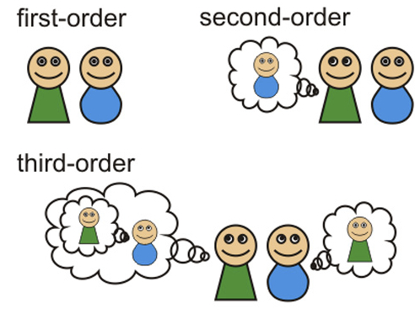

Reasoning about cause and effect
Humans have theory of mind, allowing us to
make inferences about people’s mental states
understand likely events that precede and follow
AI systems cannot do this type of reasoning
only find complex correlational patterns in training data
limited to the domain they are trained on
ATOMIC: a new knowledge graph to help AI systems perform If-Then reasoning
Notes:
Commonsense is about being able to reason about cause and effect.
AI systems are always trained for task-specific datasets and objectives,
which leads to models that are effective at finding task-specific correlations
but lack simple and explainable commonsense reasoning.
Thus, they propose Atomic

Slide 3
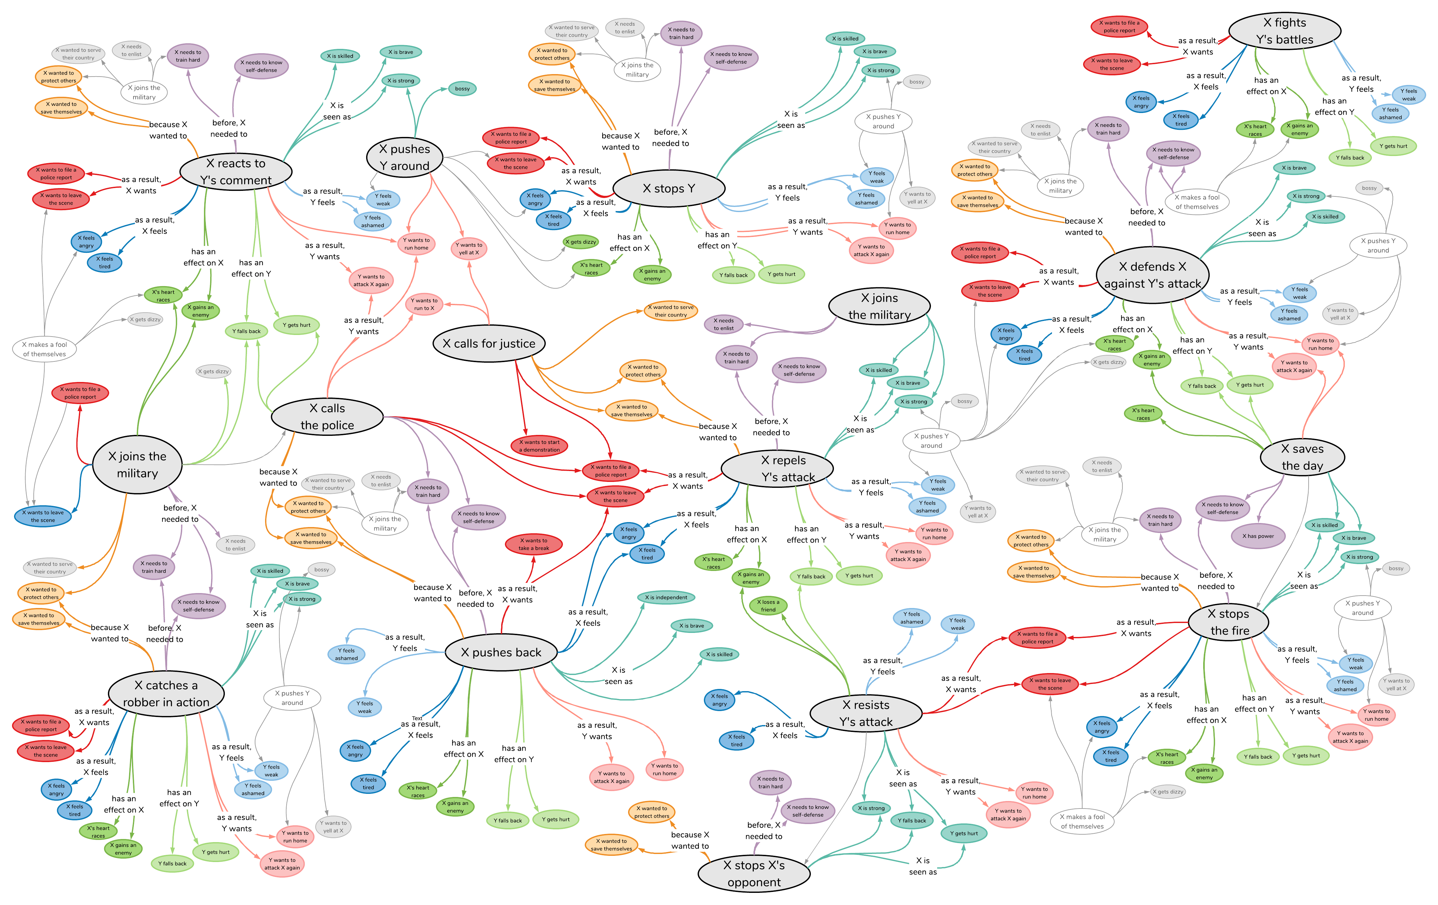
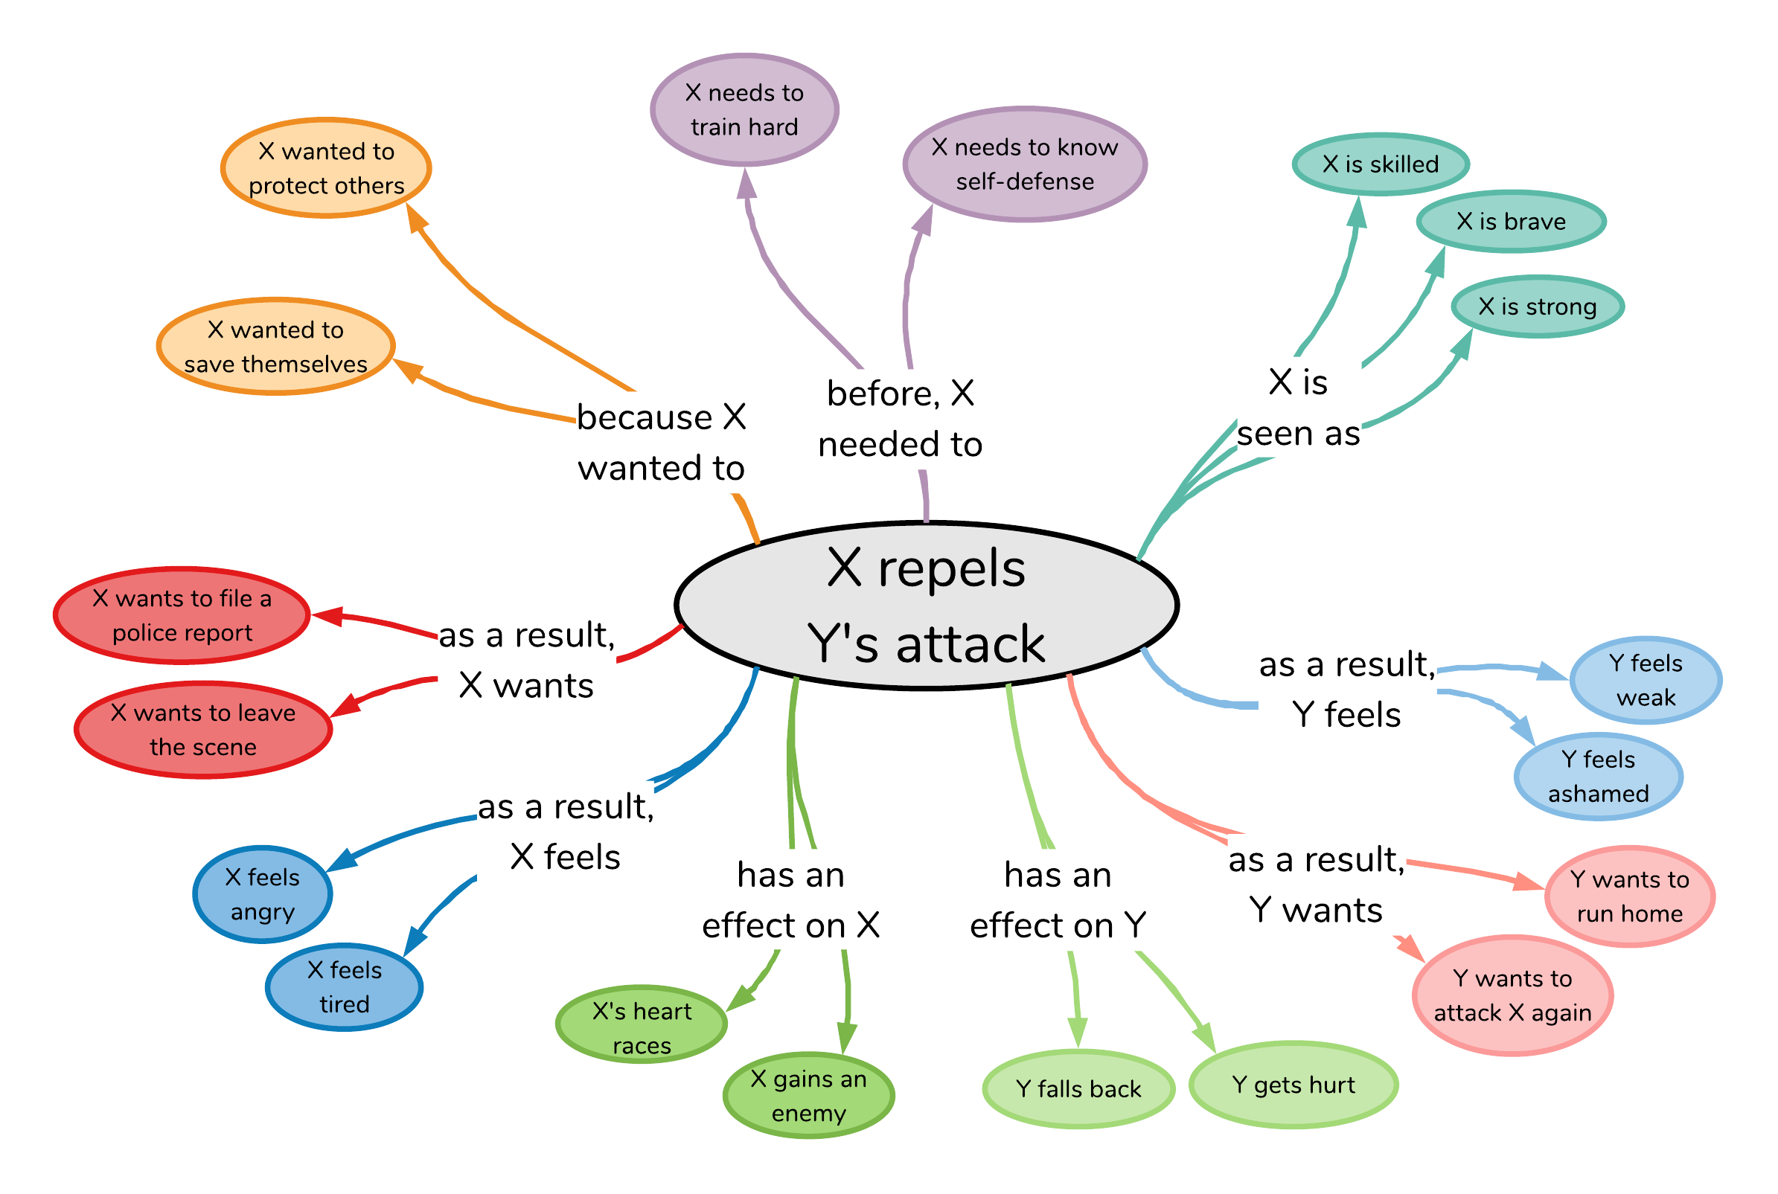

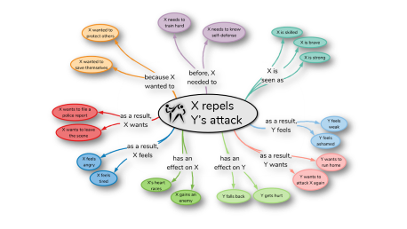
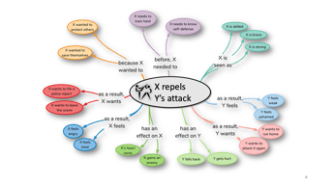
X repels Y’s attack
880,000 triples for AI systems to reason about causes and effects of everyday situations
Notes:
this HUGE knowledge graph that covers knowledge about the causes and effects

Slide 4
X repels Y’s attack
Notes:
given an event like “X repels Y’s attack”, as humans we have commonsense that allows us to give some inferences around this situation;
why did it happen? how do participants feel?

Slide 5
nine inference dimensions
X repels Y’s attack
Quiz:
How to classify these nine diimensions？
Notes:
ATOMIC distills this type of inferential knowledge into NINE different knowledge dimensions collected through crowdsourcing,
shown here around the event.
quize
These dimensions cover knowledge around the CAUSES of the event,

Slide 6

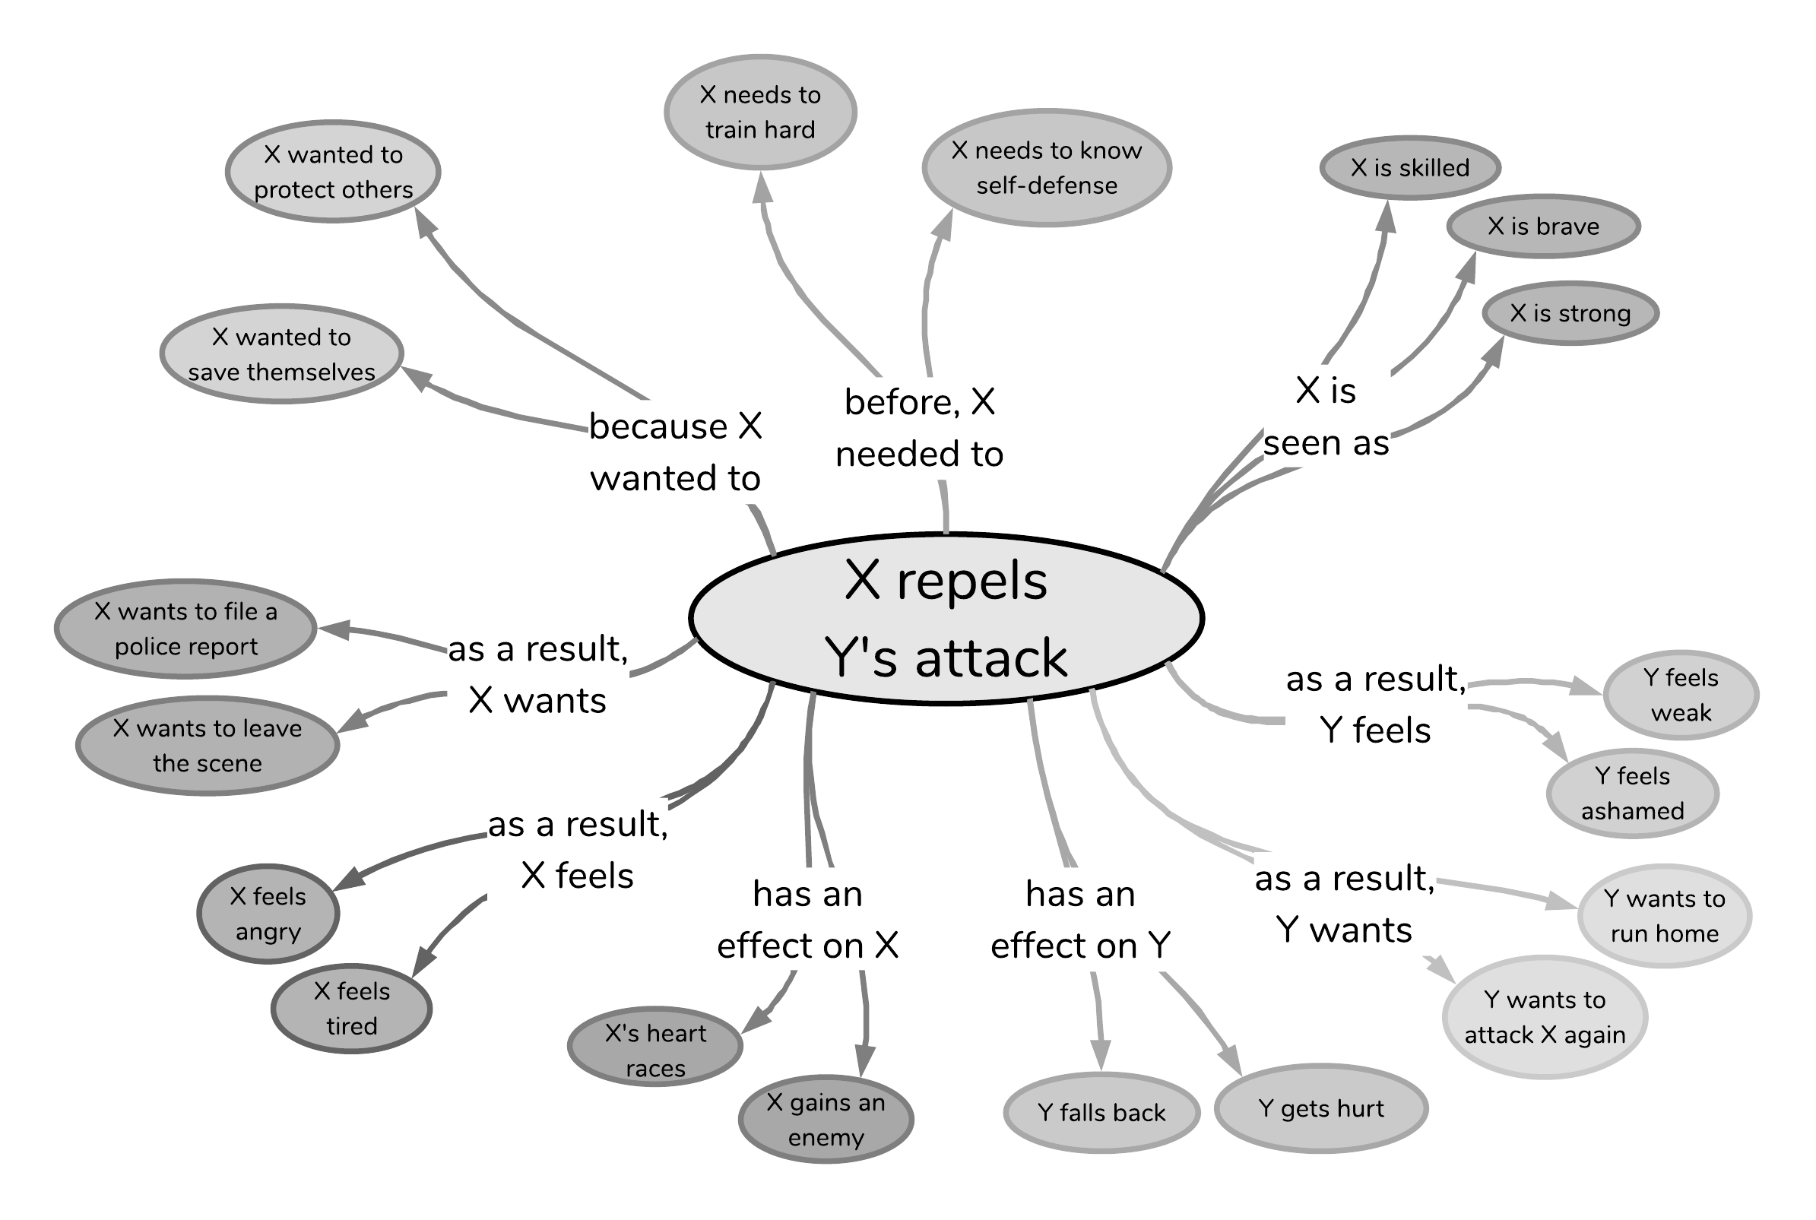
Causes
X repels Y’s attack
Effects
Notes:
And knowledge around the EFFECTS of the event

Slide 7
Static
Dynamic
X repels Y’s attack
Notes:
these cause and effect inferences in atomic are dynamic knowledge because the causes and effects of an event are various.
ATOMIC also covers static knowledge about how event participants are seen or described while the event happens, such as here where X is seen as strong, skilled or brave.

Slide 8
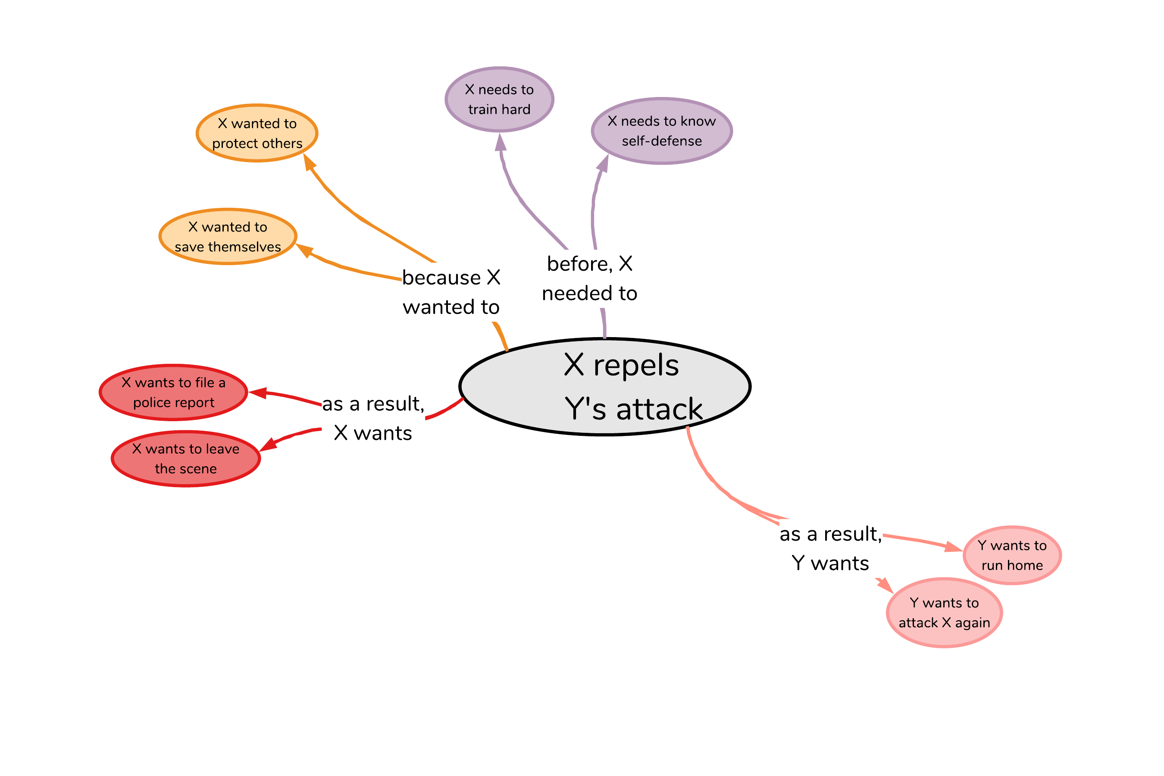
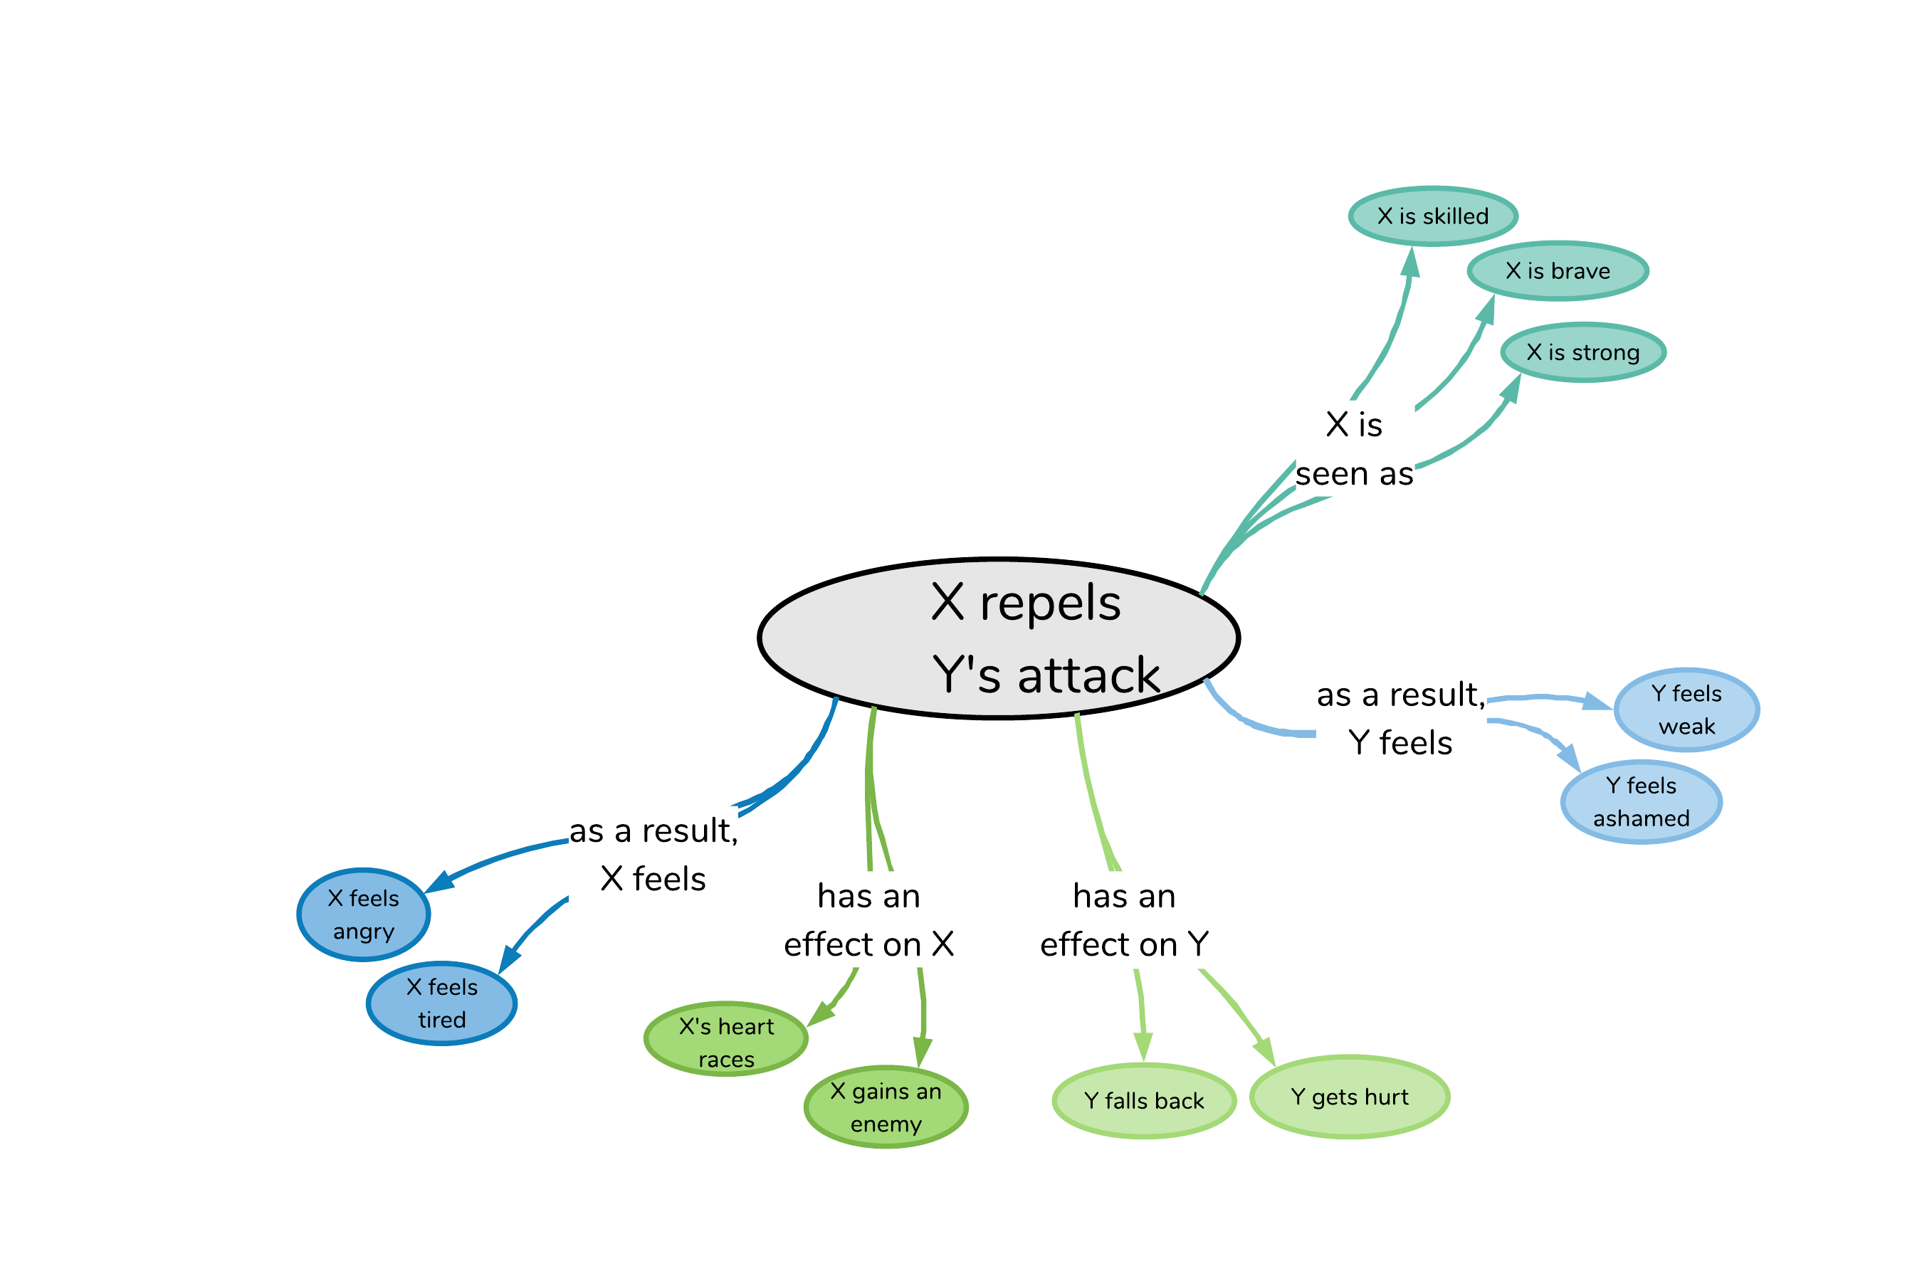

Voluntary
X repels Y’s attack
Involuntary
Notes:
Another way to look at this knowledge is in terms of volitionality.
ATOMIC covers both the voluntary dimensions, such as what people need or want to do,
and involuntary effects or implications of events, such as people’s reactions or how people are seen.

Slide 9
X repels Y’s attack
Theme
Agent
Notes:
Besides, the knowledge in ATOMIC can also be thought about in terms of “what happens to whom”.
The AGENT of the event is X,
the THEME of the event is Y

Slide 10
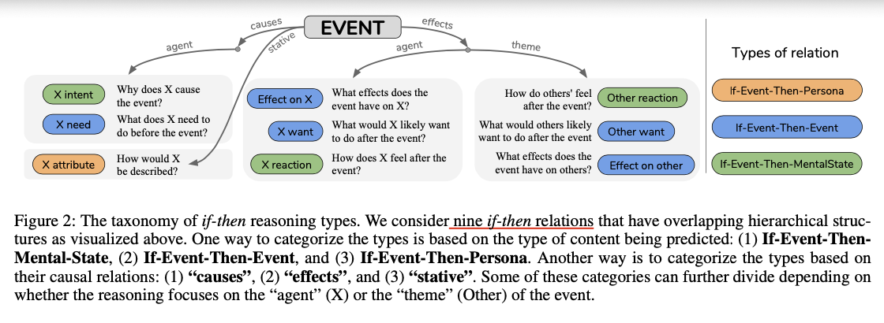
Notes:
nine dimensions span three types of If-Then relations
The relation of stative knowledge is If-event-then-persona
Define a stative relation that describes how the subject of an event is described or perceived.
three relations relating to the mental pre- and post-conditions of an event.
five relations relating to events that constitute probable pre- and post- conditions of a given event.

Slide 11
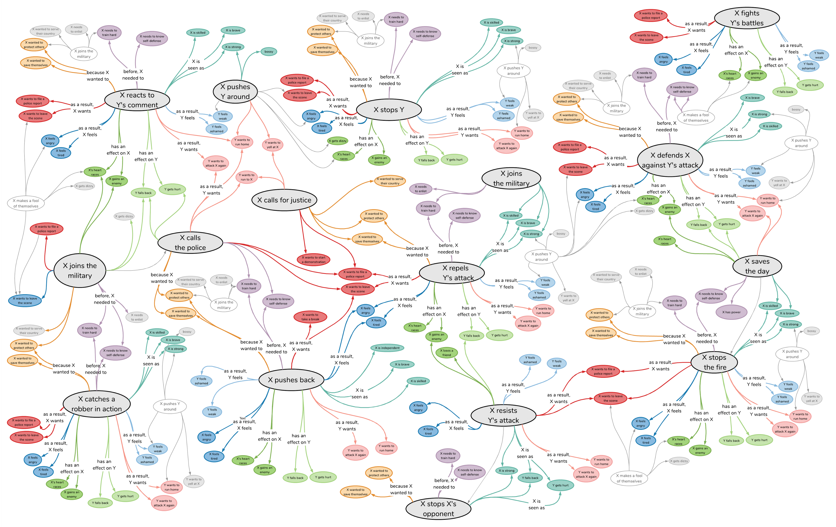
300,000 event nodes to date
880,000 if-Event-then-* knowledge triples
X repels Y’s attack
Notes:
The knowledge graph contains OVER 300 THOUSAND event nodes, connected in NEARLY 900 THOUSAND if-Event-then-SOMETHING triples

Slide 12
Existing commonsense knowledge bases
OpenCyc (Lenat, 1995)
ConceptNet (Liu & Singh, 2004)
EventNet (Espinosa & Lieberman, 2005)
Formal Theory of Commonsense Psychology (Gordon & Hobbs, 2017)
ATOMIC
Notes:
Compare previous commonsense knowledge bases and atomic

Slide 13
Existing commonsense knowledge bases
Knowledge of “what” (taxonomic: A isA B; Davis and Marcus, 2015)
Knowledge of “why” and “how”
(inferential: causes and effects)
99% taxonomic
98% taxonomic
OpenCyc (Lenat, 1995)
ConceptNet (Liu & Singh, 2004)
EventNet (Espinosa & Lieberman, 2005)
Formal Theory of Commonsense Psychology (Gordon & Hobbs, 2017)
ATOMIC
Notes:
The previous works focused on the knowledge of “what”.
Things like “water is wet”.
we found OpenCyc contains more than 99% relations that are isA taxonomic, string formatting relations, or various definitional relations.
ConceptNet provides more inferential relations (e.g., “entails”, “causes”, “motivated by”),
Which still has only about 2% of all triples in the graph.
Atomic focuses on the meaning of “why” and “how”….

Slide 14
Existing commonsense knowledge bases
Knowledge of “what” (taxonomic: A isA B; Davis and Marcus, 2015)
Knowledge of “why” and “how”
(inferential: causes and effects)
Represented in symbolic logic
(e.g., LISP-style logic)
Represented in natural language
(how humans talk and think)
99% taxonomic
98% taxonomic
OpenCyc (Lenat, 1995)
ConceptNet (Liu & Singh, 2004)
event :=
(forall (e)
(iff (event e)
(or (exists (e1 e2)
(and (nequal e1 e2)
(change’ e e1 e2)))
(exists (e1)
(subevent e1 e)))))
EventNet (Espinosa & Lieberman, 2005)
Formal Theory of Commonsense Psychology (Gordon & Hobbs, 2017)
ATOMIC
Notes:
In previous works,
The event represented in
Which shows how humans talk and think

Slide 15
How to acquire causes and effects at scale?
Notes:
So, how do we GET/DISTILL this knowledge about causes and effects AT SCALE?

Slide 16

Eliciting commonsense from people
Goals:
Quantity
Quality
Diversity
Crowdsourcing!
Design framework:
Easy to elicit commonsense knowledge around event prompts
Scalable by collecting short natural language annotations
vs. complex annotation schemes
Notes:
They don’t acquire causes and effects from text
Because text is subject to reporting bias and Commonsense is not often written

Slide 17
Notes:
Collect 300k events
Ask annotators these nine questions

Slide 18

Commonsense knowledge in ATOMIC
Goals:
Quantity
Quality
Diversity
ATOMIC:
880K if-Event-then-* triples
>85 % of triples valid in quality test
Multiple likely event interpretations
Commonsense knowledge is distributional

Slide 19
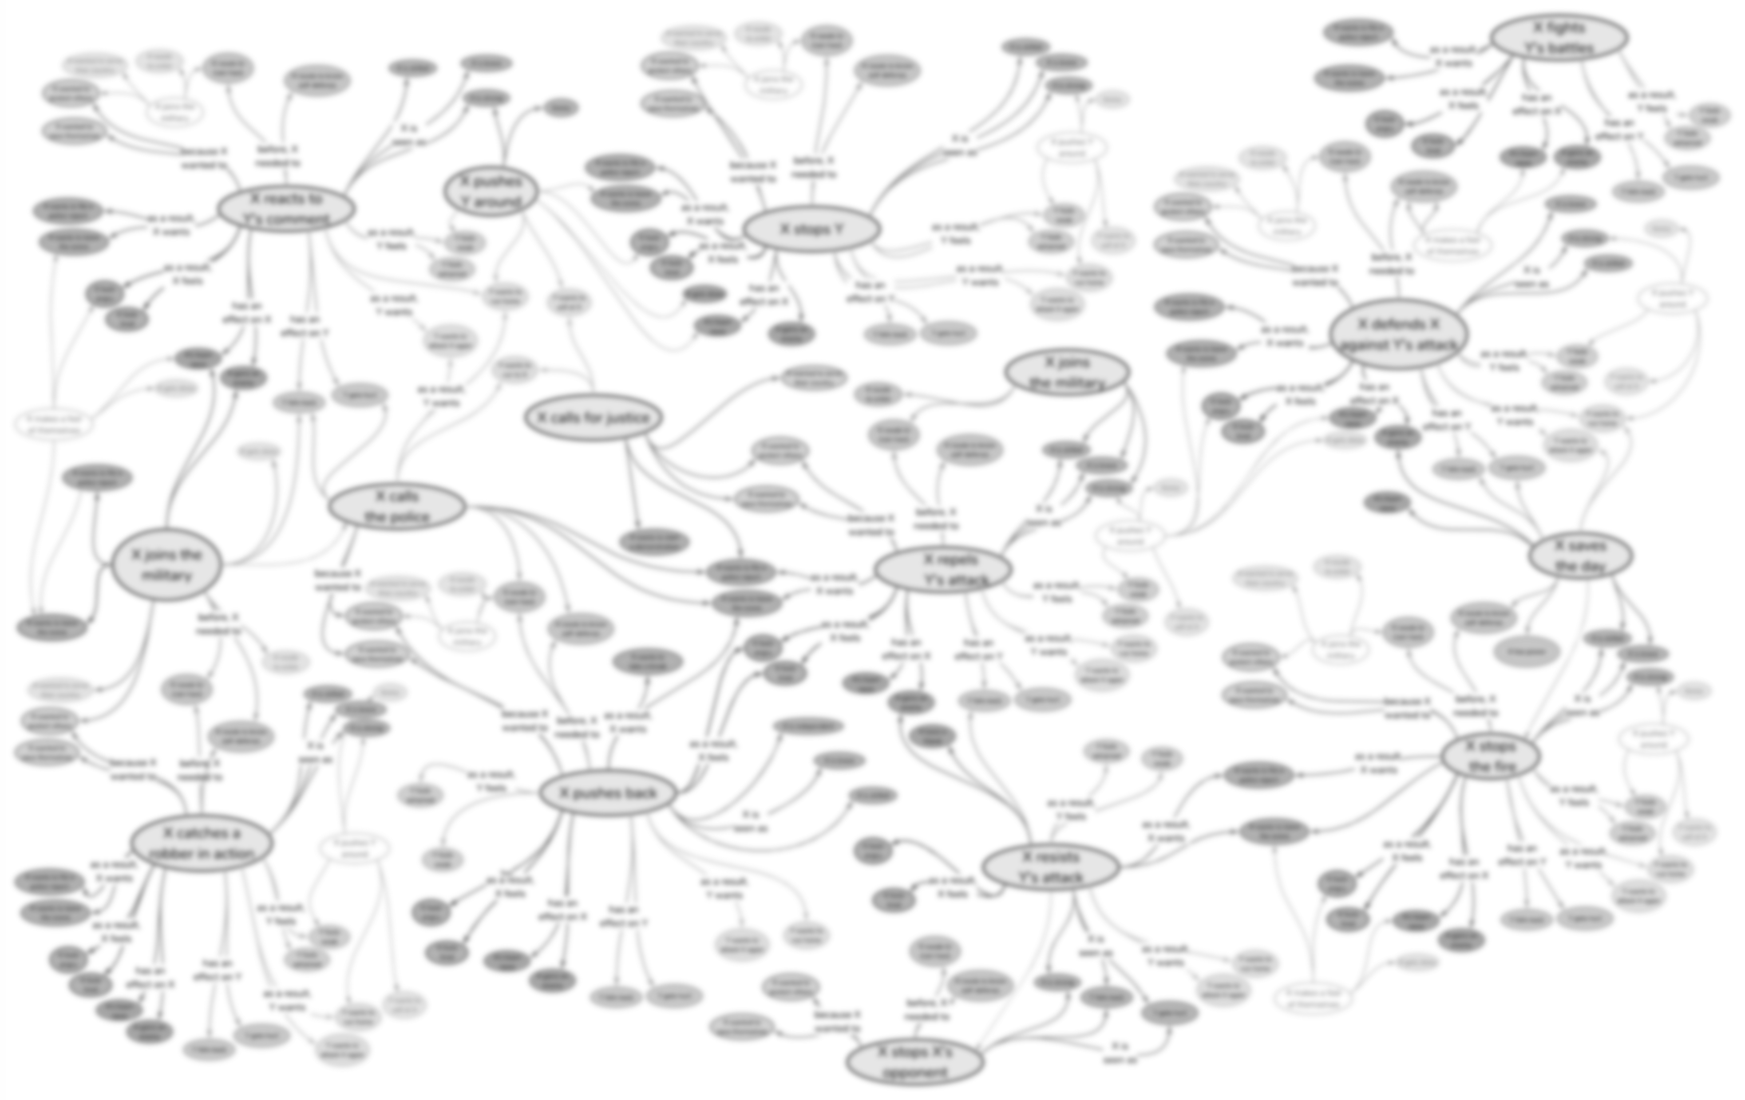

X repels Y’s attack
Can we teach models to reason about causes and effects of new events using ATOMIC?
Notes:
Another questions is

Slide 20
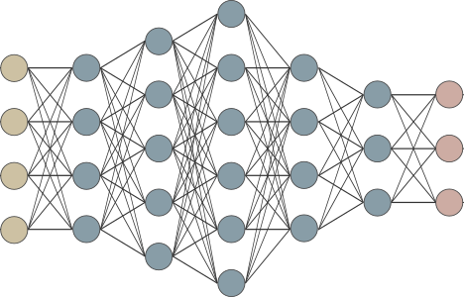
Teaching neural models cause and effect reasoning using ATOMIC
X repels Y’s attack
Can models generalize out of ATOMIC to previously unseen events?
X wanted to save themselves
Notes:
Specifically, we want them to be able to

Slide 21
Teaching neural models cause and effect reasoning using ATOMIC
X repels Y’s attack
Can models generalize out of ATOMIC to previously unseen events?
Can models exploit the structure of our nine inference dimensions?
X wanted to save themselves
X needs to train hard
Notes:
we want to know
Specifically, we want them to be able to

Slide 22
Automatic commonsense inference
Adversarial split of ATOMIC events into train/dev/test
To avoid overlap due to similar events
Encoder-decoder framework
Uni-task 9 dimension-specific encoder-decoders
Event
xIntent
Event
xNeed
Event
xAttr
Event
xReact
Event
xWant
Event
xEffects
Event
oReact
Event
oWant
Event
oEffects
Notes:
Data
Propose enc-dec to investigate whether models can learn to perform If-Then commonsense inference given a previously unseen event
It is too expensive.
So, we want them to be able to generate output on different relations by given one event

Slide 23
Multi-task
EVENT2PRE/POST
Causes
Effects
Pre- vs. post conditions
PersonX vs. PersonY
Intentional vs. unintentional
EVENT2PERSONX/Y
Agent
Theme
EVENT2(IN)VOLUNTARY
Voluntary
Involuntary
Notes:
Relation can be divided in to Three types
Train multi-task models for each relation type

Slide 24
Automatic commonsense inference
Multi-task model exploiting structure
xIntent
Encoder
xNeed
EVENT2PRE/POST
(agent PersonX)
xAttr
Event
Event
Event
Event
Event
EVENT2PERSONX/Y
Event
xReact
xWant
Encoder
xEffects
EVENT2(IN)VOLUNTARY
(theme PersonY)
oReact
Event
Event
Event
oWant
oEffects
Notes:
EVENT2PERSONX/Y: This model has one encoder for six “agent” decoders as well as another encoder for three “theme” decoders.

Slide 25
xIntent Decoder
Multi-task
protect
others
</S>
Encoder
(agent PersonX)
<S>
protect
others
xNeed Decoder
know
self
defense
</S>
ELMo
GloVe
<S>
know
self
defense
xReact Decoder
PersonX repels PersonY’s attack
feels
tired
</S>
<S>
feels
tired
Notes:
The embedding of each words in encoder is the concatenation of ElMo embedding and GloVe embedding

Slide 26
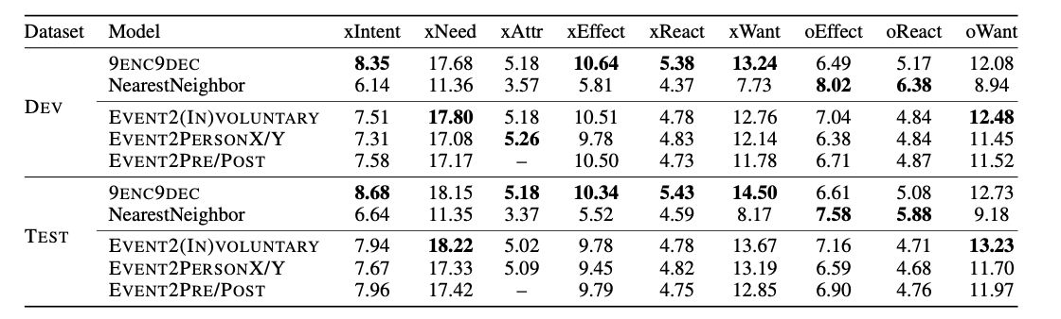
How good is the neural generation?
Automatic metrics (BLEU)
Compute the average BLEU score between each sequence in the top 10 predictions and the corresponding set of annotations.
Too brittle for natural language generation
Notes:
models that exploit the hierarchical structure of the commonsense relations perform better than the model that uses separate parameters
Model is too simple
One input corresponds to many different output during training which

Slide 27
How good is the neural generation?
Human ratings of generation quality on random 100 test events
For each event, dimension:
Top 10 most probable generations
Select all generations that are likely
Five pre-qualified workers
Distinguishing between voluntary & involuntary dimensions of event leads to better inferences
Notes:
use beam search to generate the 10 most likely inferences per dimension.
present five crowdworkers with the 10 generated inferences, and ask them to select all inferences they think are valid.
the average number of correct generations per dimension.
models that leverage the if-then hierarchy perform better than models that don’t.
explicitly modeling whether inference dimensions describe voluntary actions or involuntary effects yields more sensible generations

Slide 28





Unseen event inference
PersonX leaves without PersonY
Because X wanted to
As a result, Y might
be alone
go home
leave
go somewhere else
move on
get away from PersonY
cry
miss PersonX
be killed
miss a friend
miss his family
have a good time
p(generation)
p(generation)
Simple models can learn cause and effect reasoning, but perhaps better models are necessary
become nervous
look for PersonX
ask about PersonX
leave the person
be alone

Slide 29

Conclusion
Introduced ATOMIC, a new resource for machine commonsense
880K if-Event-then-* knowledge triples
Free-form annotations allow for efficient knowledge gathering
Models can learn to make commonsense inferences
Helpful to KB construction and causality generation

